Slide 1



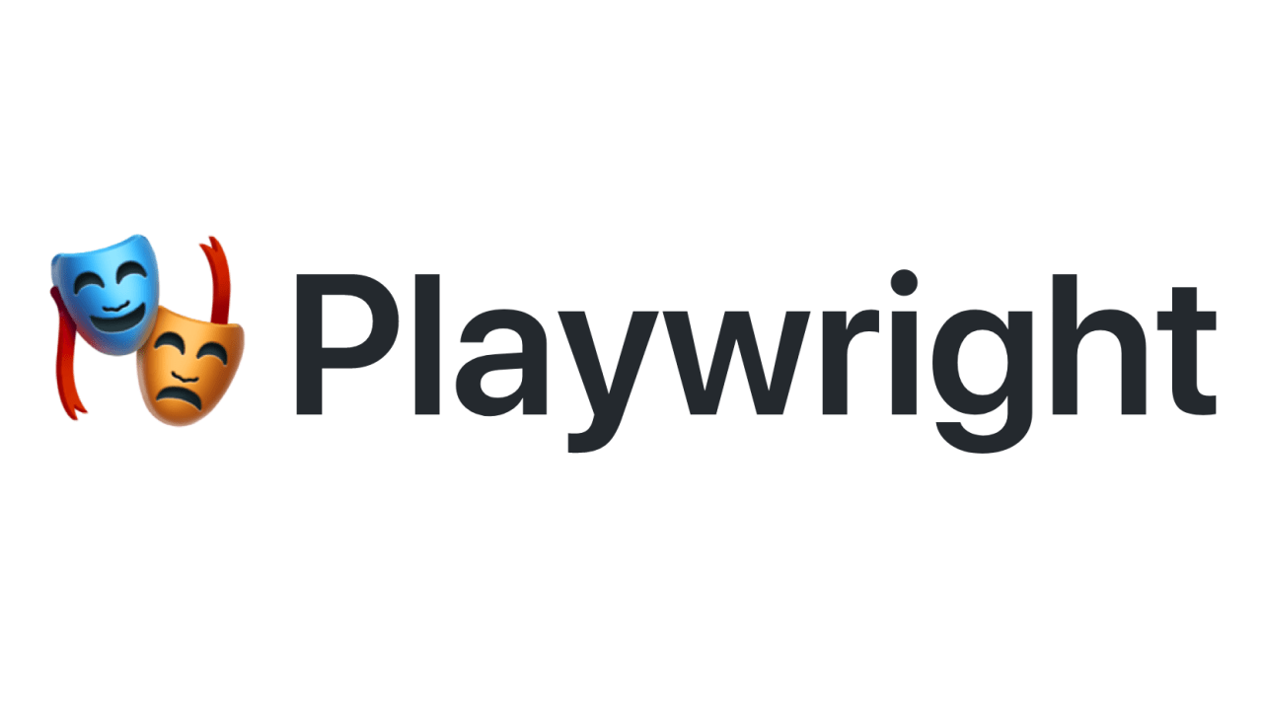
Learning PlayWright (Java)
E2E Web Testing with Playwright(Java)
Pramod Dutta
SDET Manager
Page Object model with Playwright - Part 2

Slide 2
Agenda
Create a Structure of POM

Slide 3
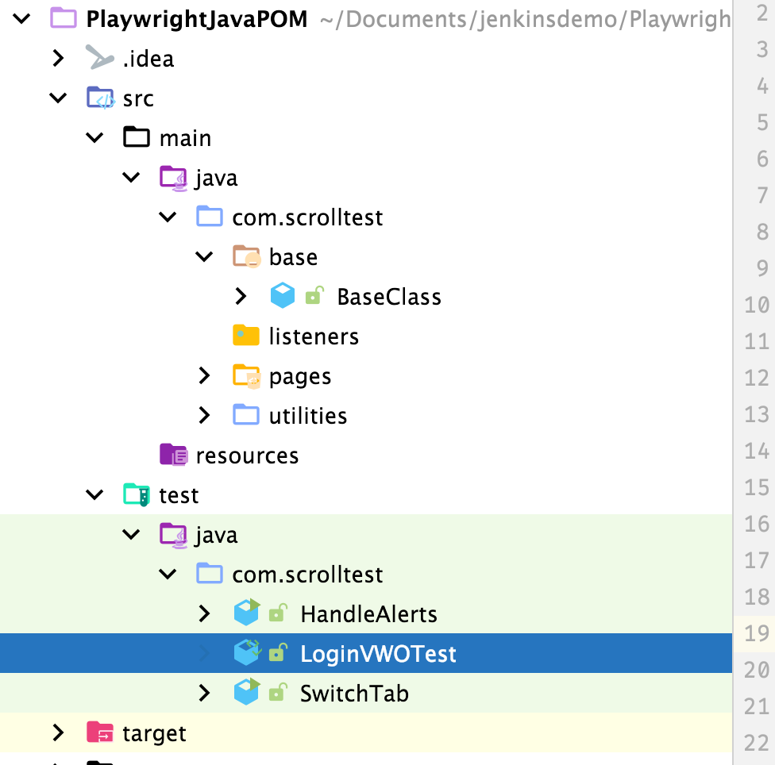
POM Folder structure

Slide 4
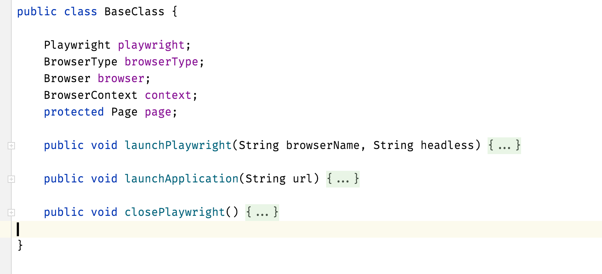
Base Class

Slide 5
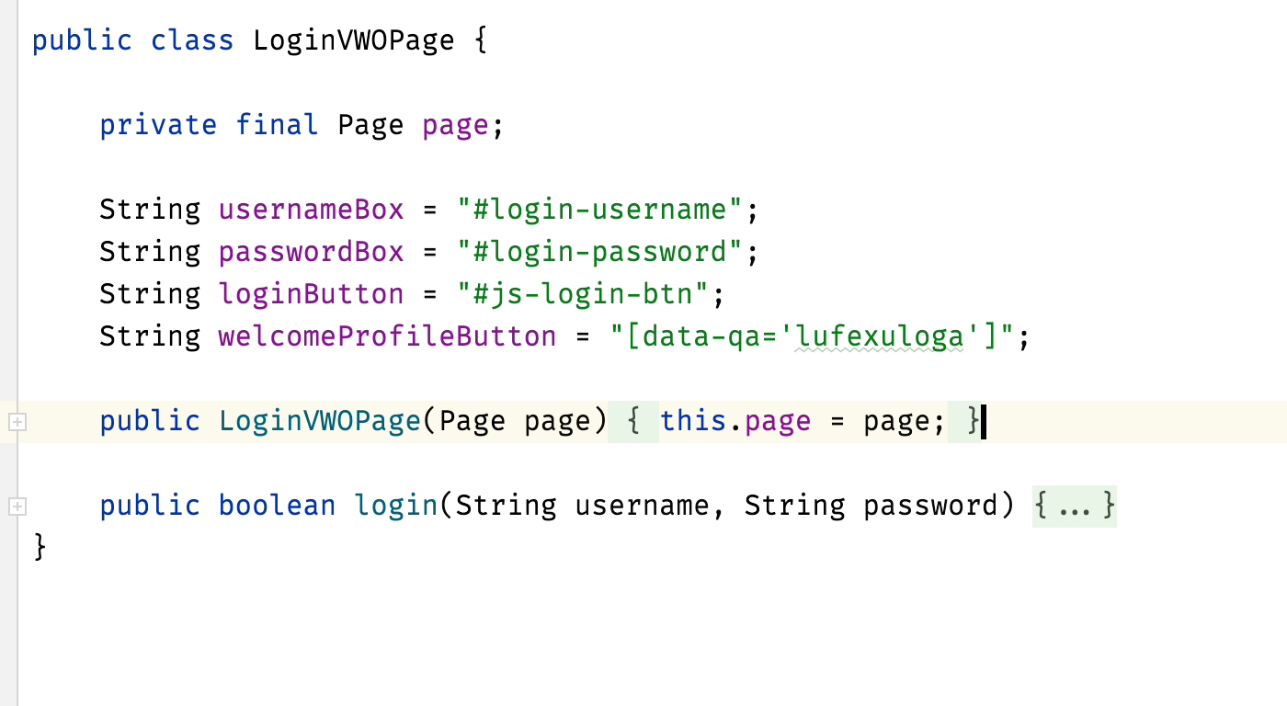
Page Class

Slide 6
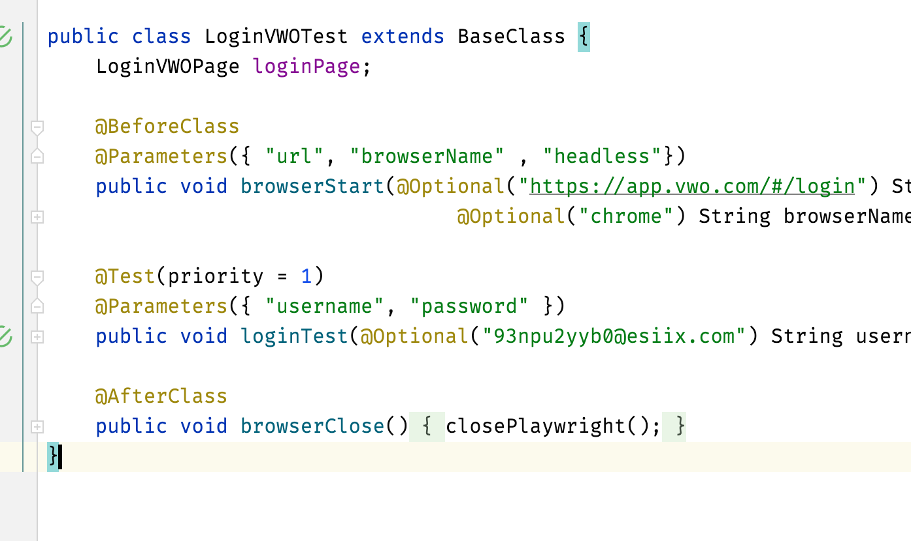
Page Test Class

Slide 7
Playwright Demo.

